Slide 1


Investigating the Effects of Perceptual Distinctiveness on Judgments of Learning
Nicholas P. Maxwell
Maca lab
The university of Southern Mississippi
Notes:
Acknowledge Trevor here!

Slide 2
Introduction
The ability to accurately judge learning progress is essential for retention
Allows modification of study strategies (Nelson & Narens, 1990)
Provides insight on how to allocate resources for future learning tasks (Soderstrom, Clark, Halamish, & Bjork, 2015)

Slide 3
Introduction
Metacognitive judgments are commonly used to obtain information about the learning process
i.e., How likely are you to remember this item pair?
Prospective vs Retrospective
Notes:
Prospective = made at encoding – how likely are you to remember this thing we’re showing you?
Retrospective = made at retrieval – how confident are you that your answer is correct?

Slide 4
Judgments of Learning
Judgment of learning (JOL)
Participants presented with cue-target pairs (e.g., mouse-cheese)and are asked to estimate their ability to recall the target item in the presence of the cue when tested later
Typically use 0-100 scale; Likert/binary ratings also used
Notes:
Judgments of learning are one of the most commonly used types of prospective judgments
So how likely would you remember mouse if you were just shown cheese?

Slide 5
Metacognitive Illusions
Metacognitive illusions occur when judgments do not accurately reflect performance
JOLs that are not calibrated with recall
Overconfidence or underconfidence
Notes:
Overconfidence = JOLs overpredict memory, underconfidence = JOLs under predict memory

Slide 6
Metacognitive Illusions
Several factors can cause metacognitive illusions including:
Associative Pair Direction (e.g., forward vs backward pairs)
Perceptual Cues that affect ease-of-processing (e.g., clarity, size, etc.)

Slide 7
Influence of Pair Direction
Associative direction affects magnitude of JOLs and recall
Forward – Credit - Card
Backward – Card - Credit
Symmetrical – King – Queen
Unrelated – Muffin - Floor
Notes:
Backward and symmetrical pairs are tricky because participants perceive these pairs as related and assume they will be easy to remember at test. However they do poorly at test for these types

Slide 8
Influence of Pair Direction
Koriat & Bjork’s (2005) Illusion of Competence
Notes:
JOLs = predicted memory, Recall = actual memory
Maxwell and Huff extended this to include symmetrical pairs (KING-QUEEN)

Slide 9
Perceptual Cues and Judgment Making
Ease-of-processing can also influence judgment making
Participants are more likely to indicate they know the answer to a question when the question is easy to read (Werth & Strack, 2003)
Authors were judged as more intelligent when text passages were presented in easy-to-read font (Oppenheimer, 2006)
Notes:
Perceptual clarity has been shown to affect magnitude of judgments
Even when judging two unrelated concepts (font clarity and author intelligence)

Slide 10
Perceptual Cues and JOLs
Rhodes & Castel (2008) extended this finding to JOLs
Font-Size effect in which JOLs differed as a function of font-size
Higher JOLs for large font
Lower JOLs for small font
Recall did not differ as a function of font-size
Notes:
Participants studied all unrelated items and took a free recall test

Slide 11
Rhodes & Castel (2008) Experiment 1

Slide 12
Rhodes & Castel (2008) Experiment 1
Notes:
JOLs increase for large font relative to small

Slide 13
Rhodes & Castel (2008) Experiment 1
Notes:
But recall stays the same. Notice that recall is much lower than JOLs. This is because Castel et al used unrelated word pairs, which participants tend to judge high but are bad at recalling

Slide 14
Fluency vs Beliefs
Debate regarding how perceptual cues affect JOLs
Fluency – Large font words are easier to process at encoding
Beliefs – Individuals have certain beliefs about stimuli (Large words are easy to remember)
Notes:
Fluency: JOLs are inflated because stim is easier to encode
Beliefs: JOLs are inflated because participants believe large words are easier to recall at test.

Slide 15
The Present Study
Provide further test of the font-size effect (Ex 1 and 2)
Include other perceptual manipulations that could affect fluency/beliefs
Highlighting (Ex 1 and 2)
Sans Forgetica font (Ex 3)

Slide 16
The Present Study
Experiment 1: Small vs Large font and highlights
Experiment 2: Small vs Large font and highlights
Experiment 3: Sans Forgetica Font
Notes:
Briefly mention what SF is

Slide 17
Experiment 1: Font-Size and Highlights
Provides an additional test of the font-size effect
Tests whether effect extends to highlighting
Tests the effect of associative direction
Notes:
Selected highlighting because its typically done to denote important information (e.g., highlighting while studying)

Slide 18
Experiment 1: Hypotheses
JOLS should be inflated for large font pairs and highlighted pairs
Recall should not differ as a function of font-size or highlighting
Notes:
These predictions are based on Rhodes & Castel, 2008. (Font-size by measure interaction)

Slide 19
Experiment 1: Participants and Materials
121 Participants recruited from Prolific
180 word pairs generated from the Nelson et al. (2004) free association norms.
40 Forward pairs (e.g., credit-card), 40 backward pairs (card-credit), 40 symmetrical pairs (king-queen), 40 unrelated pairs (artery-bronze).
20 untested buffers
Notes:
Participants completed the study online
Pairs split into two study lists, 20 of each pair type plus 10 buffers
Pairs controlled for concreteness, length, and frequency. Lists were matched on Forward and backward associative strengths.
Four counterbalances that swapped block order and flipped pairs within lists (forward pairs in version 1 would be backward in version 2)

Slide 20
Experiment 1: Procedure
Participants were randomly assigned to one of three groups:
Font-Size (n = 41)
Highlight (n = 41)
Control (n = 39)
Pair direction was manipulated within subjects
Notes:
Font-size group: Mixed list where half of the pairs were presented in 54 pt font, other half in 12 pt font
Highlight: half of the pairs were highlighted in yellow, other half were not. All pairs presented in 32 point font
Control: All pairs presented in 32 point font. No highlights
All participants studied each of the four pair types

Slide 21
Experiment 1: Procedure
Study
Arithmetic Filler Task
Recall
3 Groups:
Font-Size, Highlight, Control
Notes:
Study was conducted online w/ Collector. Participants completed two study/test blocks.

Slide 22
Experiment 1: Font-Size Analyses
2 (Measure: JOL vs Recall) x 2(Font-Size: Large vs Small) x 4 (Pair Type: Forward vs Backward vs Symmetrical vs Unrelated) ANOVA
2 (Measure: JOL vs Recall) x 2 (Encoding Group: Large vs Control) x 4 (Pair Type: Forward vs Backward vs Symmetrical vs Unrelated) ANOVA
2 (Measure: JOL vs Recall) x 2 (Encoding Group: Small vs Control) x 4 (Pair Type: Forward vs Backward vs Symmetrical vs Unrelated) ANOVA
Notes:
First tested font-size effect
Then compared Small and large font to control separately

Slide 23
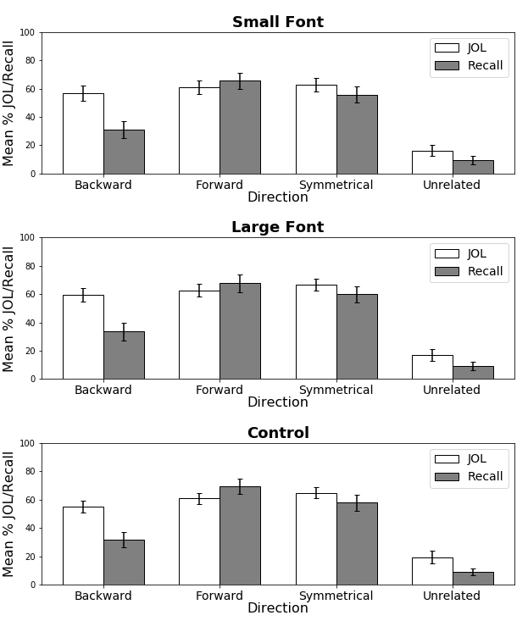
Results
Notes:
Looking at Small and Large:
Main Effect of Measure
Main Effect of Pair Type
Main Effect of Font-Size
No Interactions with Font-Size

Slide 24
Results
Notes:
JOLs/Recall small font did not significantly differ from control
**Font-size effect failed to replicate as both JOLs and Recall increased equivalently for large font items
Rather than only boosting JOLs as predicted**

Slide 25
Results
Notes:
JOLs/Recall for large font did not significantly differ from control
**Font-size effect failed to replicate as both JOLs and Recall increased equivalently for large font items
Rather than only boosting JOLs as predicted**

Slide 26
Experiment 1: Highlight Analyses
2 (Measure: JOL vs Recall) x 2(Highlight: Highlight vs No-Highlight) x 4 (Pair Type: Forward vs Backward vs Symmetrical vs Unrelated) ANOVA
2 (Measure: JOL vs Recall) x 2(Encoding Group: Highlight vs Control) x 4 (Pair Type: Forward vs Backward vs Symmetrical vs Unrelated) ANOVA
2 (Measure: JOL vs Recall) x 2(Encoding Group: Highlight vs Control) x 4 (Pair Type: Forward vs Backward vs Symmetrical vs Unrelated) ANOVA
Notes:
First tested whether JOLs and Recall differed as a function of highlighting
Then compared highlight and no highlight separately to the control group

Slide 27
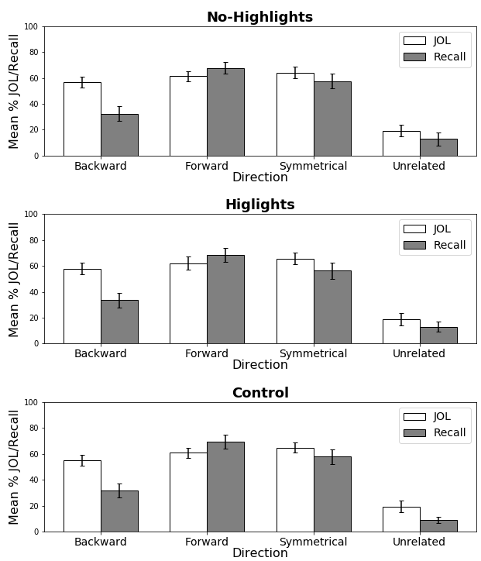
Results
Notes:
First Looking at Highlights and no-highlights
Main Effect of Measure
Main Effect of Pair Type
No Main Effect of Highlighting
No Interactions with Highlighting

Slide 28
Results
Notes:
Now comparing non-highlighted to control
JOLs/Recall for not-highlighted pairs did not significantly differ from control

Slide 29
Results
Notes:
Now comparing highlighted pairs to control
JOLs/Recall for highlighted pairs did not significantly differ from control

Slide 30
Experiment 1: Summary
Font-Size effect failed to replicate
Highlighting had no effect on JOLs or recall
Notes:
Small increase to JOLs/Recalls (averaged together) but no interaction between Font-size and measure as predicted by font-size effect

Slide 31
Experiment 2: Font-Size and Highlights for Unrelated Pairs
Castel & Rhodes (2008) showed that the font size effect was greatly diminished when using a mix of related and unrelated pairs.
Experiment 2 tested whether the effect would replicate when only using unrelated pairs
Notes:
Thus, Ex 2 provides a direct replication

Slide 32
Experiment 2: Hypotheses
JOLS should be inflated for large font pairs and highlighted pairs
Recall should not differ as a function of font-size or highlighting
Notes:
Same predictions as Ex 1

Slide 33
Experiment 2: Participants and Materials
108 Participants recruited from Prolific
180 word pairs generated from the Nelson et al. (2004) free association norms.
Only unrelated pairs this time!

Slide 34
Experiment 2: Procedure
Participants were randomly assigned to one of three groups:
Font-Size (n = 37)
Highlight (n = 38)
Control (n = 33)
Same procedure as Ex 1
Notes:
Same design as EX 1 except this time participants only studied unrelated pairs.

Slide 35
Experiment 2: Procedure
Study
Arithmetic Filler Task
Recall
3 Groups:
Font-Size, Highlight, Control
Notes:
Same procedure as Ex 1, the only difference was the stimuli used
Participants completed two blocks

Slide 36
Experiment 2: Font-Size Analyses
2 (Measure: JOL vs Recall) x 2 (Font-Size: Small vs No-Large) ANOVA
2 (Measure: JOL vs Recall) x 2 (Encoding Group: Large vs Control) ANOVA
2 (Measure: JOL vs Recall) x 2 (Encoding Group: Small vs Control) ANOVA
Notes:
First tested font-size effect

Slide 37
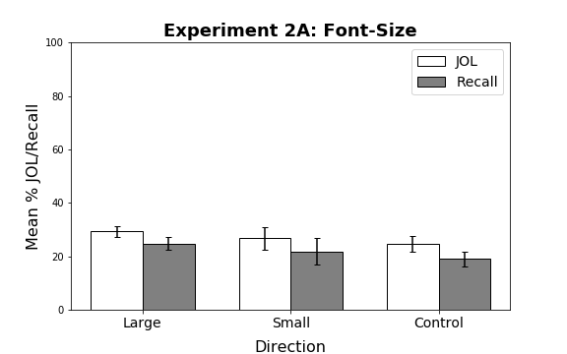
Results
Notes:
No Main Effect of Measure
Effect of Font-Size
No Interaction

Slide 38
Results
Notes:
For Large font:
JOLs/Recall for largepairs did not significantly differ from control

Slide 39
Results
Notes:
For Small font:
JOLs/Recall for small pairs did not significantly differ from control

Slide 40
Experiment 2: Highlight Analyses
2 (Measure: JOL vs Recall) x 2(Highlight: Highlight vs No-Highlight) ANOVA
2 (Measure: JOL vs Recall) x 2 (Encoding Group: Highlight vs Control) ANOVA
2 (Measure: JOL vs Recall) x 2 (Encoding Group: No-Highlight vs Control) ANOVA

Slide 41
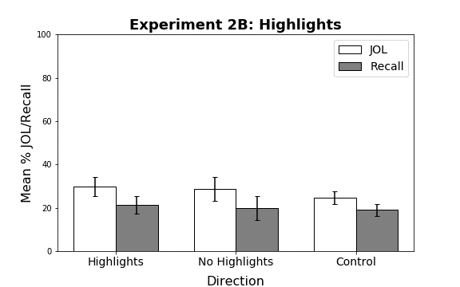
Results
Notes:
No Main Effect of Measure
No Main Effect of Highlighting
No Interactions with Highlighting
JOLs/Recall for highlighted and not-highlighted pairs did not significantly differ from control

Slide 42
Results
Notes:
For highlighted pairs
JOLs/Recall for highlighted pairs did not significantly differ from control

Slide 43
Results
Notes:
For non-highlighted pairs
JOLs/Recall not-highlighted pairs did not significantly differ from control

Slide 44
Experiment 2: Summary
Font-Size effect again failed to replicate
Highlighting again had no effect on recall or JOLs
Notes:
Even when using only unrelated pairs! JOLs and Recall were both increased for large font

Slide 45
Experiment 3: Sans Forgetica
Experiment 3 tested the effects of Sans Forgetica on JOLs and Recall

Slide 46
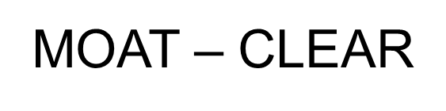
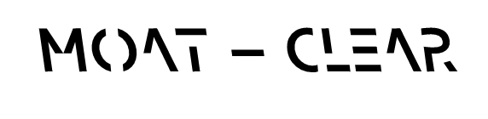
Experiment 3 – Sans Forgetica
Sans Forgetica (SF) is a special font that is supposed to enhance memory.
Notes:
Basically, having to put more effort into encoding should result in better memory. SF should benefit memory because its harder to read.

Slide 47
Experiment 3 – Sans Forgetica
Sans Forgetica (SF) is a special font that is supposed to enhance memory.
Based on “desirability difficulty” (Bjork & Bjork, 2011)
However, not all difficulties are desirable and difficulties that are desirable in one context may not be in another (McDaniel & Butler, 2010)

Slide 48
Experiment 3 – Sans Forgetica
Recent research suggests that SF doesn’t actually benefit memory (Taylor, Sanson, Burnell, Wade & Garry, 2020)
However, because SF is more distinct, JOLs may be increased for SF font.
Notes:
And this seems to be the case w/ SF

Slide 49
Experiment 3: Hypotheses
Words presented in Sans Forgetica font should receive higher JOLs relative to Arial Font
Recall will not differ as a function of font type
Notes:
Based on studies showing SF doesn’t benefit memory and aligns w/ predictions from font-size effect.

Slide 50
Experiment 3: Participants and Materials
86 Participants completed Ex 3
33 recruited from Prolific
53 recruited from Sona
6 particpants were excluded for not following instructions
Same unrelated stimuli pairs as Ex 2
Notes:
No differences were found as a function of recruitment platform
80 Participants in the final dataset.
All done online

Slide 51
Experiment 3: Procedure
Participants were randomly assigned to one of two groups:
Sans Forgetica (n = 39)
Control (n = 41)
Notes:
Control group: All pairs presented in standard 32 pt Arial font
SF Group: Half of the pairs presented in SF, half presented in 32 pt Arial
Sans Forgetica and standard font pairs were matched on size (32 pt). The font type was the only thing that differed.

Slide 52
Experiment 3: Procedure
Study
Arithmetic Filler Task
Recall
2 Groups:
Sans Forgetica and Control
Notes:
Same general procedure previous two experiments

Slide 53
Experiment 3: Analyses
2 (Measure: JOL vs Recall) x 2(Font: SF vs Arial) ANOVA
2 (Measure: JOL vs Recall) x 2 (Encoding Group: SF vs Control) ANOVA
2 (Measure: JOL vs Recall) x 2 (Encoding Group: Arial vs Control) ANOVA
Notes:
And then analyses followed the same design

Slide 54
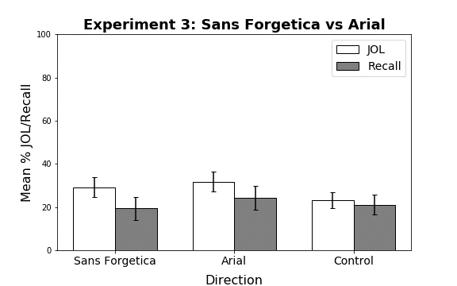
Results
Notes:
Sans Forgetica vs Arial:
Main Effect of Measure
Main Effect of Font
No Interaction

Slide 55
Results
Notes:
For SF vs Control
No difference between SF pairs and Control

Slide 56
Results
Notes:
For Arial vs Control:
Arial pairs had higher JOLs/Recall relative to Control

Slide 57
Experiment 3: Summary
Sans Forgetica font did not increase JOLs
Cost to both JOLs and Recall!
Sans Forgetica = Sans Remembrica!
Arial pairs presented alongside SF pairs had higher JOLs and recall relative to control group

Slide 58
Summary and Discussion
Test whether perceptually distinct pairs would affect beliefs about memory performance
Replicate the font-size effect
Extend to other perceptual manipulations
Notes:
But not memory!

Slide 59
Summary and Discussion
Failed to replicate Rhodes & Castel (2008)
Large font produces some benefit for both JOLs and recall (Ex 1 and 2)
Failed to extend to highlights and Sans Forgetica (Ex 3)
Perceptually distinctive pairs do not seem to selectively benefit JOLs!

Slide 60
Limitations and Future Directions
Use of cued-recall vs free-recall
Online Testing
Measure fluency via reaction times
Assess participant beliefs at encoding
Notes:
Castel & Rhodes found the effect using free-recall whereas we used cued-recall

Slide 61
QUESTIONS?

